Slide 2
Lesson 1
6
5
2
3
4
Notes:
Click on the words, they will move and match up with the pictures.

Slide 3
Monday, September 6th, 2021
UNIT 1: HOME
Lesson 1
I. Vocabulary
pool (n)
: bể bơi
balcony (n)
: ban công
garage (n)
: nhà để xe ô tô
yard (n)
: sân
gym (n)
: phòng tập thể dục
apartment (n)
: căn hộ

Slide 4
Lesson 1
My house has ………..
There is a ………. in my house.
My house has a balcony.
There is a balcony in my house.
My house has a yard.
There is a yard in my house.
My house has two yards.
There are two yards in my house.

Slide 5
Lesson 1
an apartment
bedrooms
pool
garage

Slide 6
II. Grammar: THE PRESENT SIMPLE
I / You / We / They + V
He / She / It + Vs/es
+
Ex: I live in an apartment.
She lives in an apartment.
I / you / we / they + don’t + V
He / she / it + doesn’t + V
-
Ex: They don’t live in a house.
My house doesn’t have a pool.

Slide 7
Do + you / we / they + V ?
Yes, I/ we/ they + do.
No, I/ we/ they + don’t.
Does + he / she / it + V ?
Yes, he/ she/ it + does.
No, he/ she/ it + doesn’t.
?
Ex: Do you live in a house?
Yes, I do.
Does she live in a house?
No, she doesn’t.
NOTE:
have: dùng cho chủ từ là I/ you/ we/ they/ N số nhiều
has: he/ she/ it/ N số ít
Ex: I have a house.
My house has a yard.

Slide 8
Lesson 1

Slide 9
Lesson 1
have
live
lives
doesn’t have
live
have

Slide 10
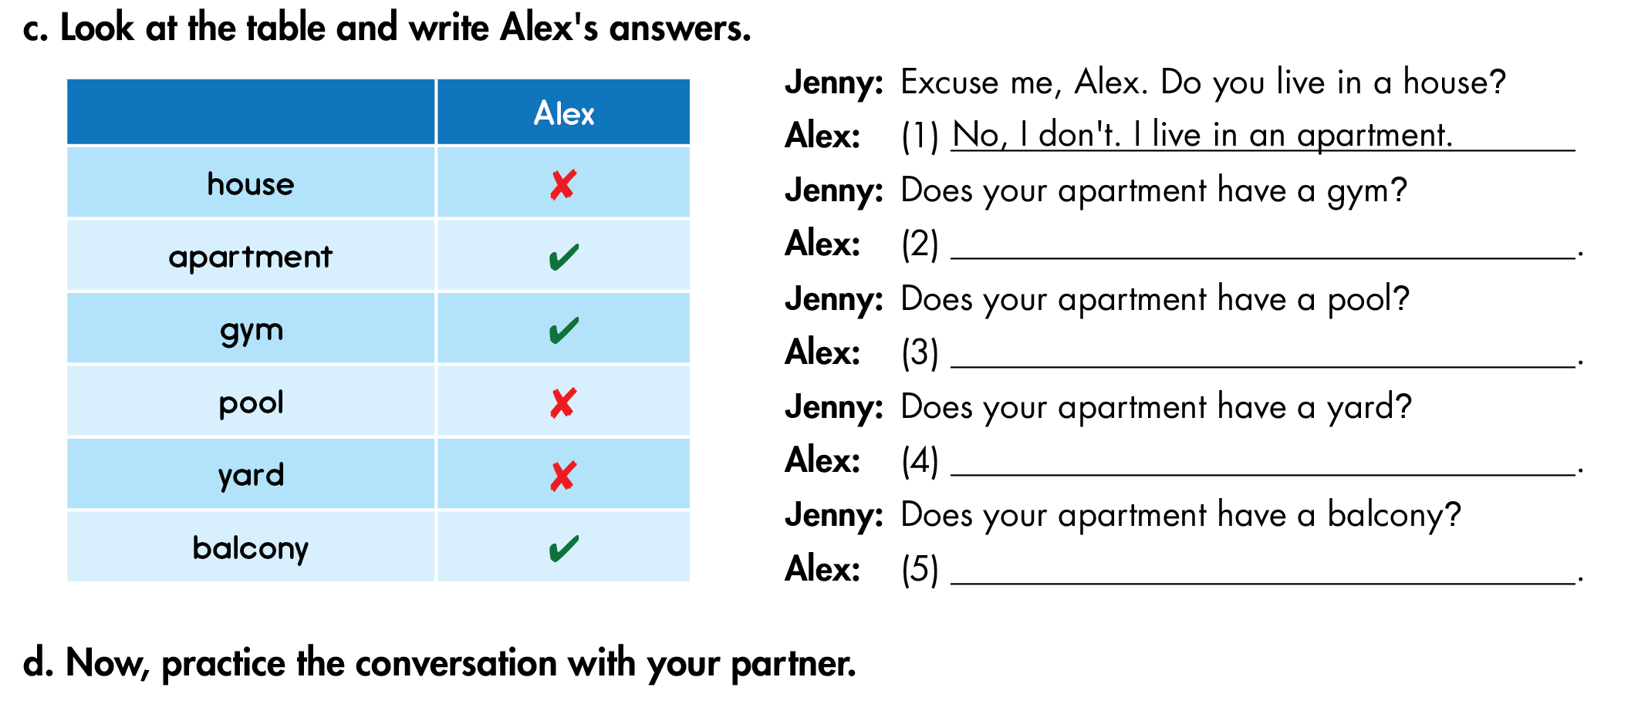
Lesson 1
Yes, it does.
No, it doesn’t.
No, it doesn’t.
Yes, it does.

Slide 11
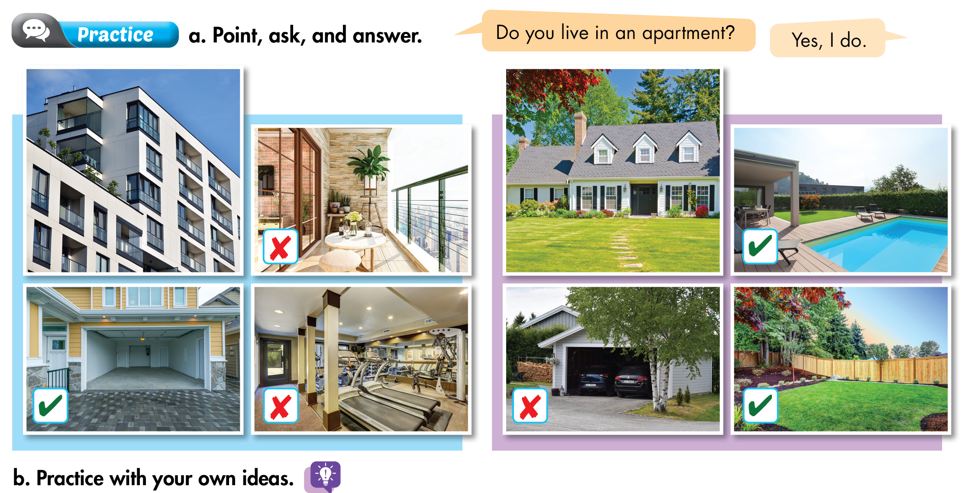
Lesson 1
A
B
Do you live in a/an……..?
→ Yes, I do./ No, I don’t.
Does your apartment/ house have ……..?
→ Yes, it does./ No, it doesn’t.

Slide 12
I. Học thuộc Vocabulary.
II. Write 5 sentences about your house.
(Viết 5 câu miêu tả ngôi nhà của bản thân.)
- My house has ........................
- My house has ........................
- There is a/ an.....................................in my house.
- There are ..........................................in my house.
- It doesn’t have ...................................

Slide 13
III. Sắp xếp các từ sau thành câu hoàn chỉnh:
they/ car/ Do/ a/ have?
→ Do they have a car?
2. lives/ She/ apartment/ an/ in.
3. have/ your/ Does/ house/ balcony/ a?
4. live/ Alex/ in/ Does/ a/ house?
5. Lan/ live/ and/ her family/ Hanoi/ in.
6. house/ has/ My/ pool/ a.

Slide 14
IV. Tìm và sửa lỗi sai trong các câu sau:
I doesn’t live in a house.
Do Tom live in an apartment?
My house don’t have a yard.
Do you haves a dog?
They lives in Ho Chi Minh City.
My brother live in Hanoi.
______
→ don’t

